Slide 1

Prepared by: Lekh Bdr. Bhujel
Grade: XII Roll No.: 19
Faculty: Science

Slide 2
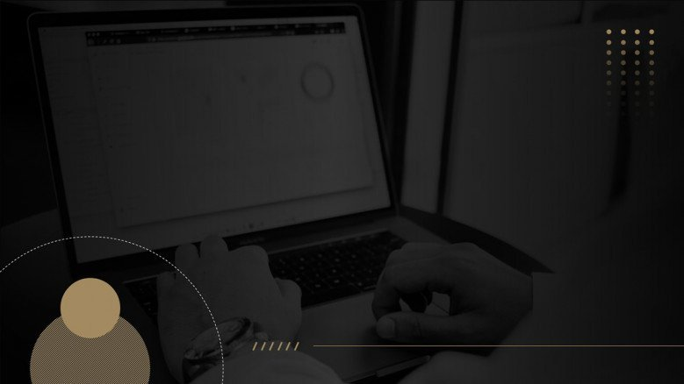
COMPUTER NETWORK
Basis of Size
PAN
Basis of Architecture
Client-Server
LAN
MAN
WAN
Peer-to-Peer
Things to Discuss:

Slide 3
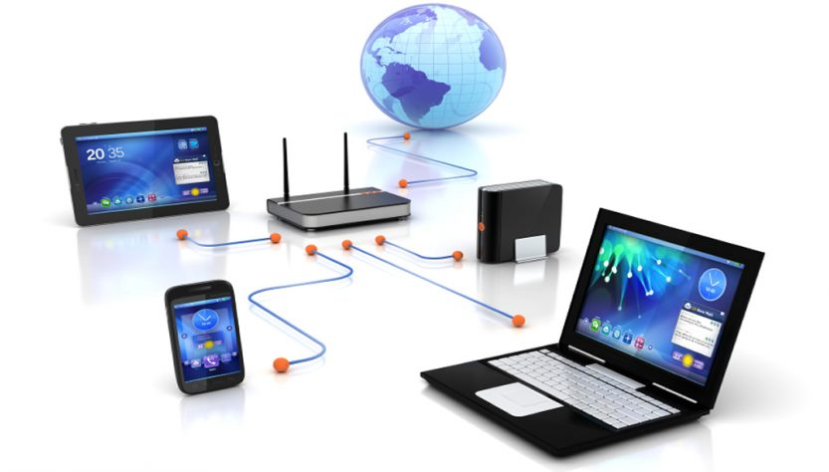
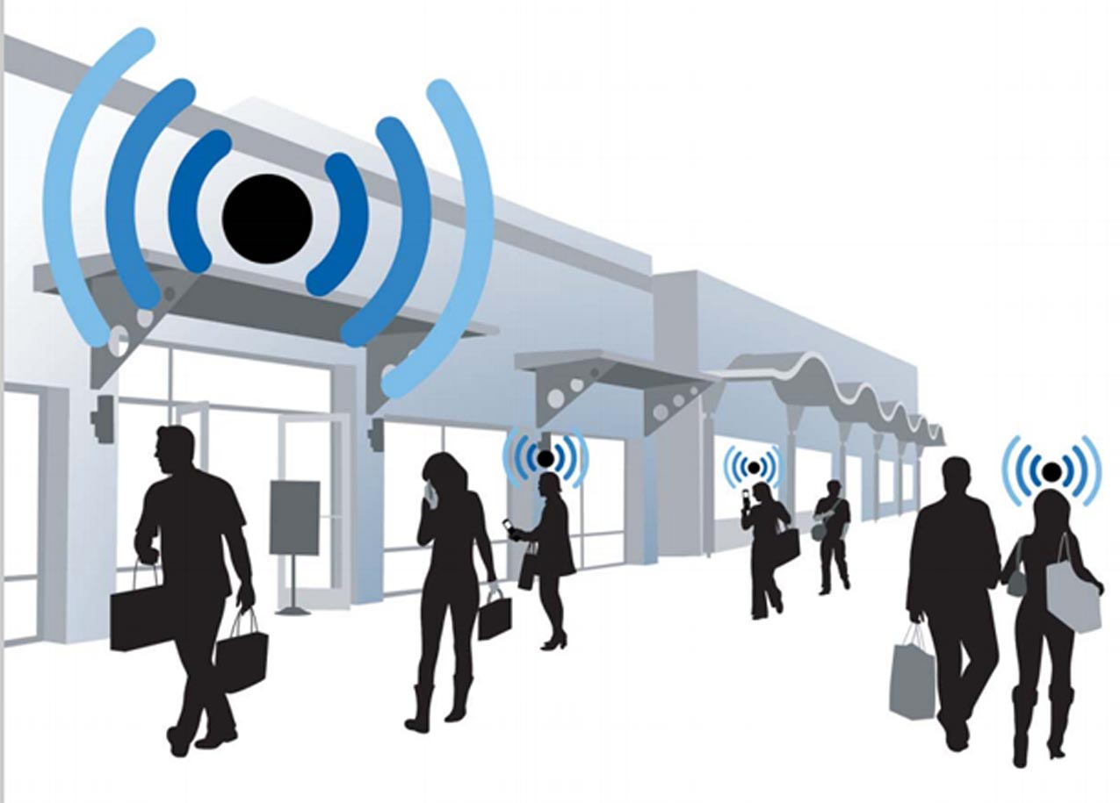
Computer Network
A computer network is a group of computers connected with each other through a transmission medium such as cable, wire etc.

Slide 4
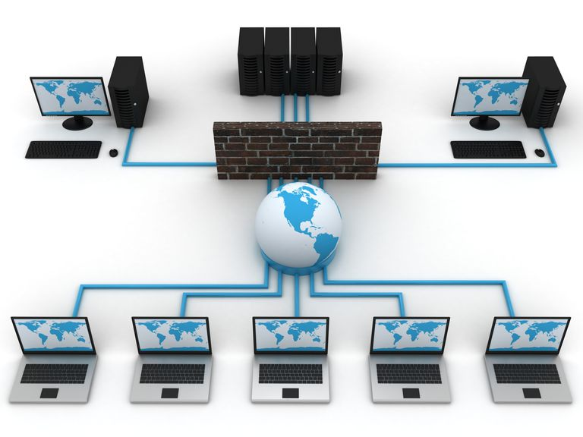
Types of Computer Network
On the basis of size:
Personal Area Network (PAN)
Local Area Network (LAN)
Metropolitan Area Network(MAN)
Wide Area Network (WAN)
2. On the basis of Architecture:
Client-Server Network
Peer-to-Peer Network

Slide 5
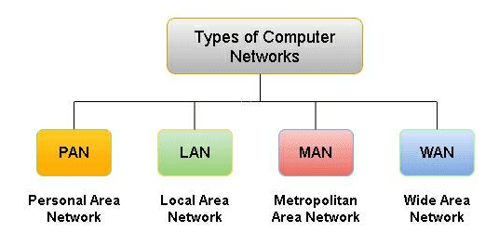
On the basis of Size

Slide 6
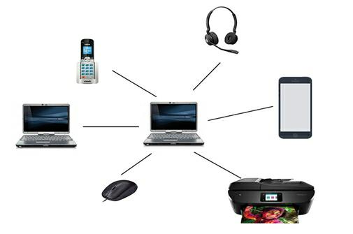
Personal Area Network (PAN)
Computer network that connects computers or devices within the range of an individual person
Involves a computer, phone, tablet, printer & other entertainment devices

Slide 7
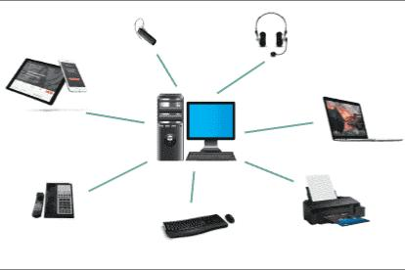
Personal Area Network (PAN)
Advantages:
No need extra space
Connect to many devices at a time
Cost effective
Easy to use
Reliable and Portable
Secure
Used in office, Conference and meetings

Slide 8

Personal Area Network (PAN)
Disadvantages:
Less distance range
Interfere with radio signals
Slow data transfer
Health Problem
Costly in terms of Communication devices
Infrared signals travel in straight line

Slide 9
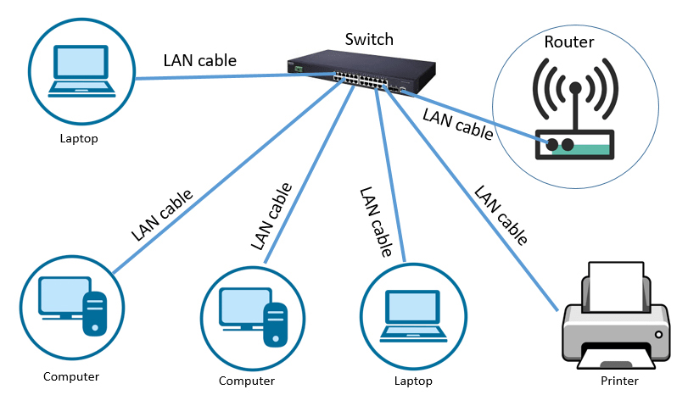
Local Area Network (LAN)
Computer network that interconnects computers within a limited area
Small places such as school, hospital, apartment etc.

Slide 10
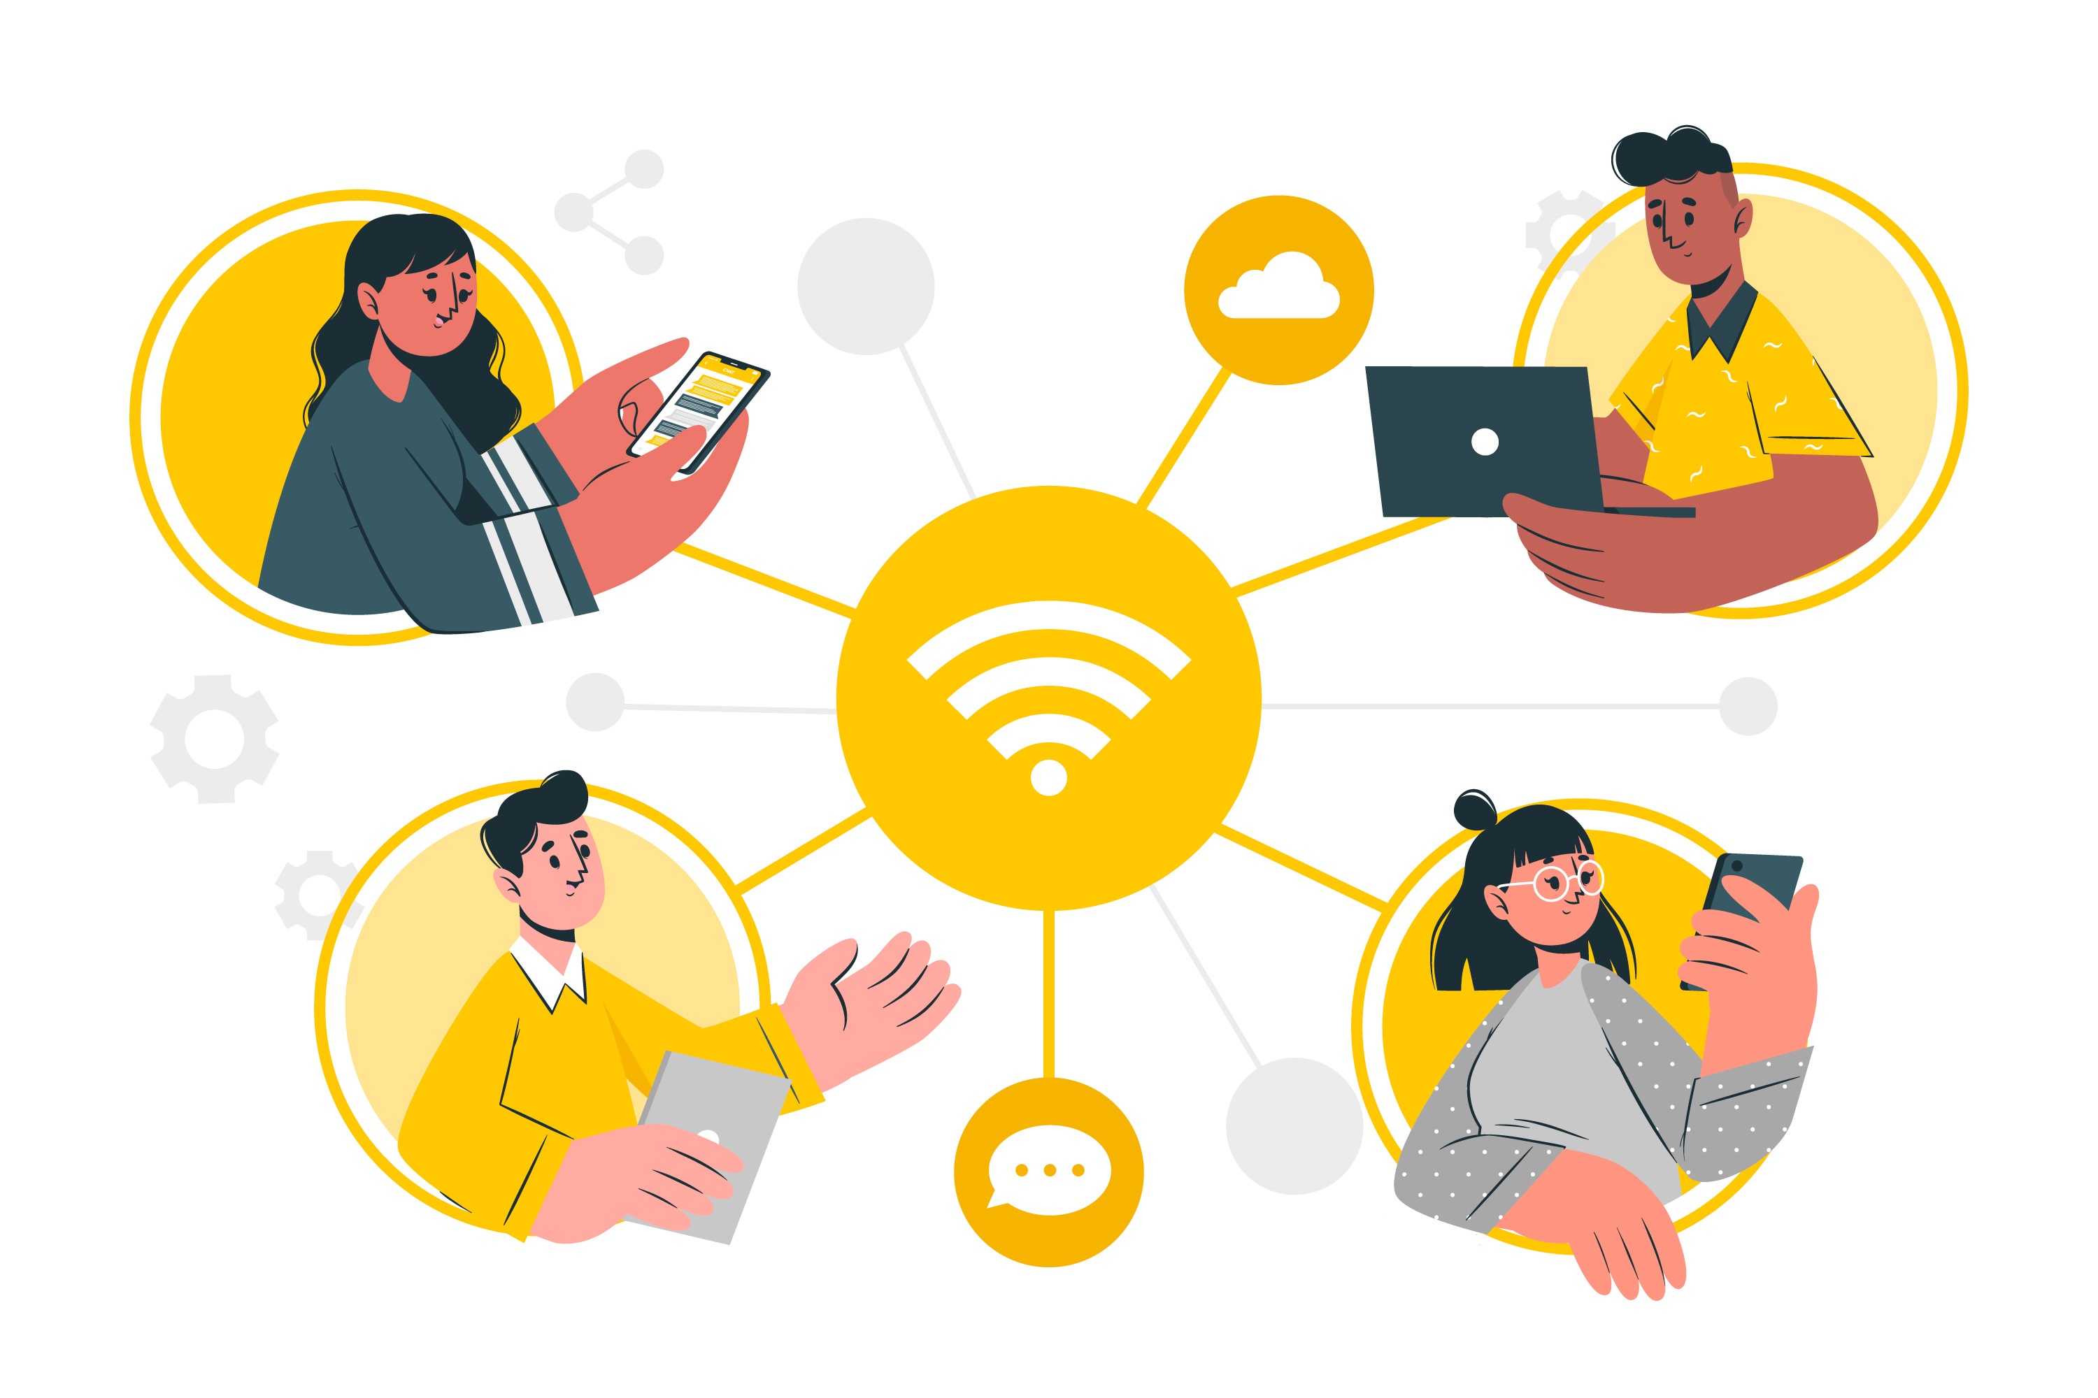
Local Area Network (LAN)
Advantages
Hardware and software can be shared
Does not cost too much
Private ownership
Separate component
Data transfer rate is higher
All the user work can be stored in a central place hub

Slide 11

Local Area Network (LAN)
Disadvantages
Difficult to set up
Security violations
Cable may break
File server my fail
A virus can be spread more easily
A limited number of a system can only be connected
Covers a small geographical area

Slide 12
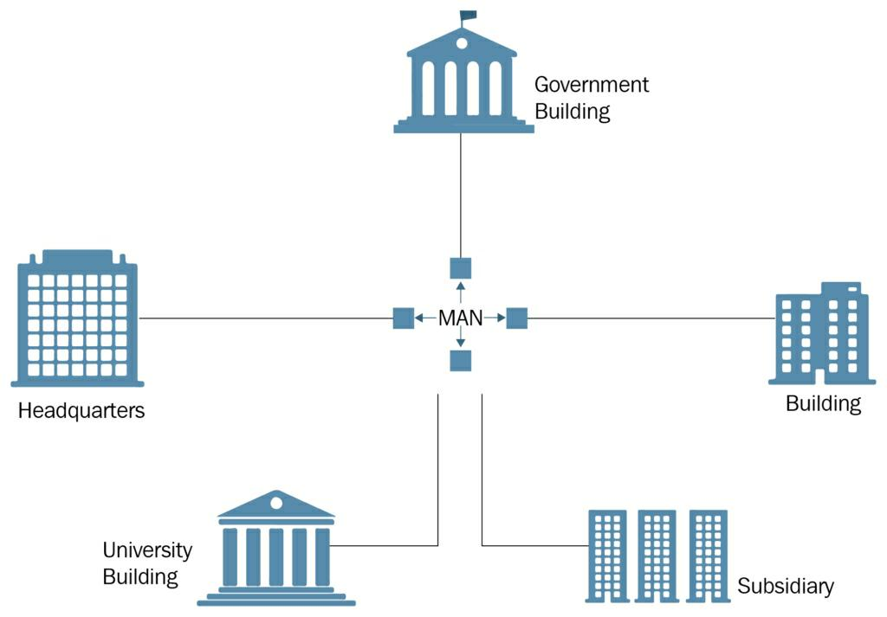
Metropolitan Area Network (MAN)
Computer network that interconnects users with computer resources in a geographic region of the size of a metropolitan area
Larger than LANs but smaller than WANs

Slide 13

Metropolitan Area Network (MAN)
Advantages
Less Expensive than WAN
Sending Local Emails
High speed than WAN
Sharing of the Internet
High security
Conversion of LAN to MAN is easy

Slide 14

Metropolitan Area Network (MAN)
Disadvantages
Difficult to manage
Expensive than LAN
Hackers Attack
Need more wires
Requires Technical staff to set up

Slide 15
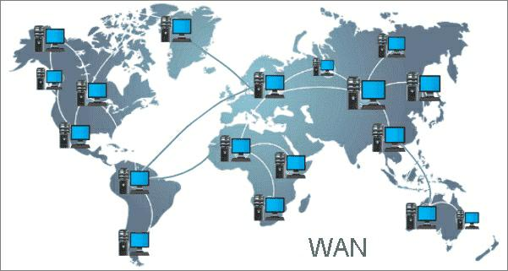
Wide Area Network (WAN)
Large computer network that connects groups of computers over large distances
Often used by large businesses to connect their office networks

Slide 16
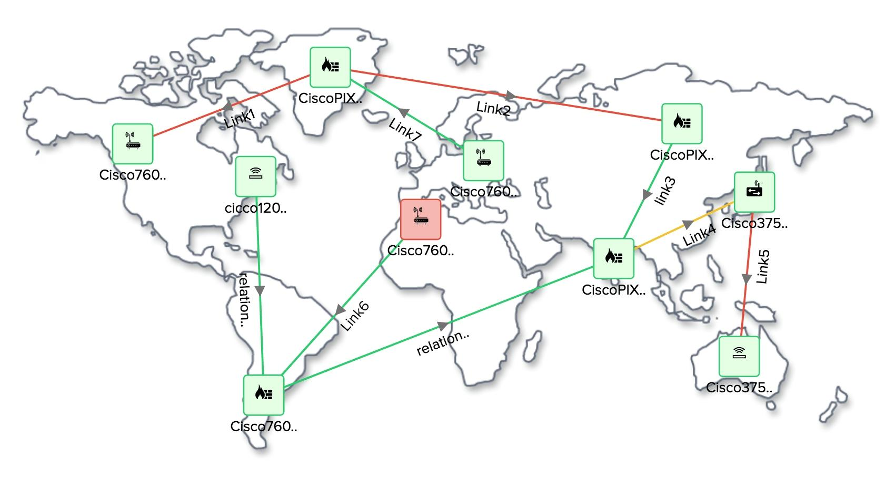
Wide Area Network (WAN)
Advantages
Increase efficiency
Easy way of communication
Large network cover
Boost your privacy
Centralized IT infrastructure
Share information over the large area

Slide 17

Wide Area Network (WAN)
Disadvantages
Security Problem
Not Reliable
Slow in speed
Expensive
Maintainance problem
Difficult to maintain network
Require high performance devices

Slide 18
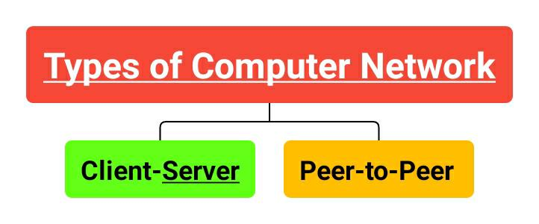
On the basis of Architecture

Slide 19
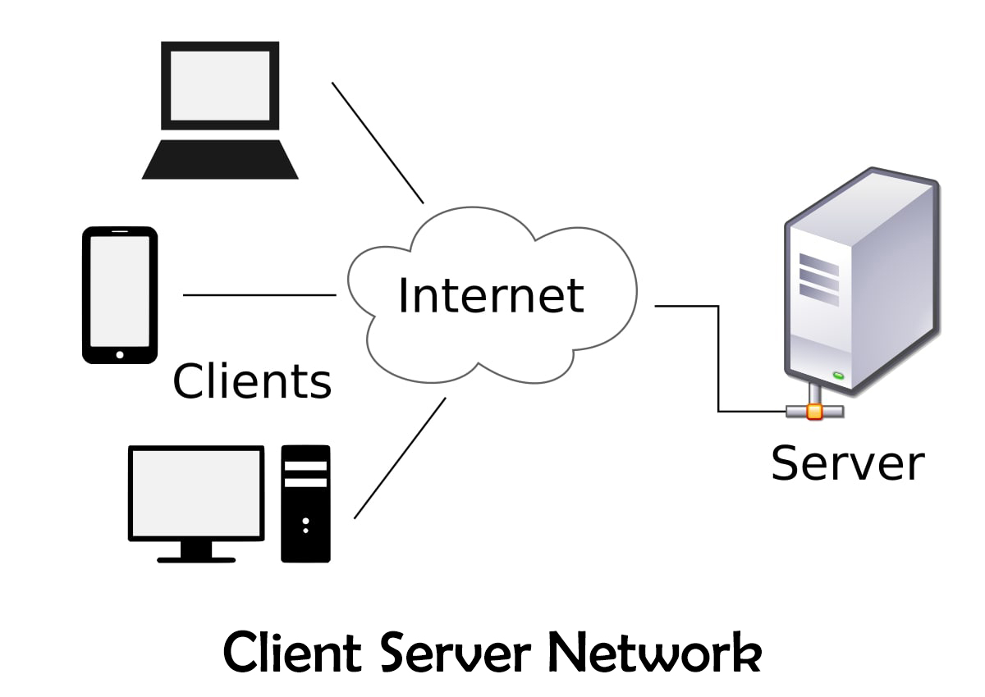
Client-Server Network
In this network, Clients and Servers are differentiated which means specific server & clients are present
Focuses on information sharing
Centralized server is used to store data

Slide 20
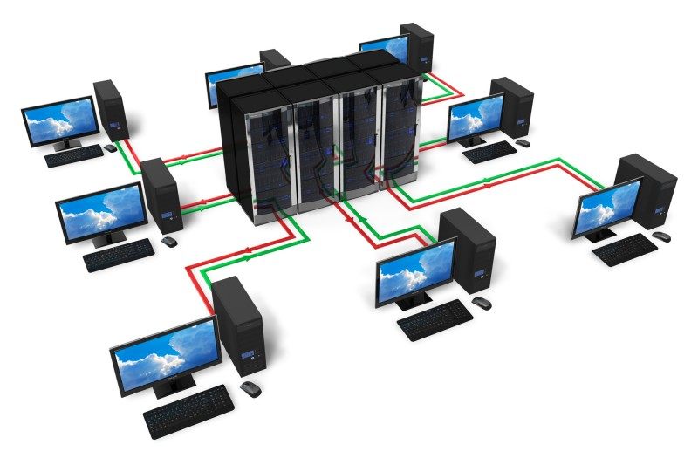
Client-Server Network
Advantages
Centralization of control
Dedicated Server
Scalability
Easy Maintainance
Accessibility
Back and Recovery possible

Slide 21

Client-Server Network
Disadvantages
A specialist network operating system is needed
The server is expensive to purchase
Specialist staff such as a network manager is needed
If any part of the network fails a lot of disruption can occur

Slide 22
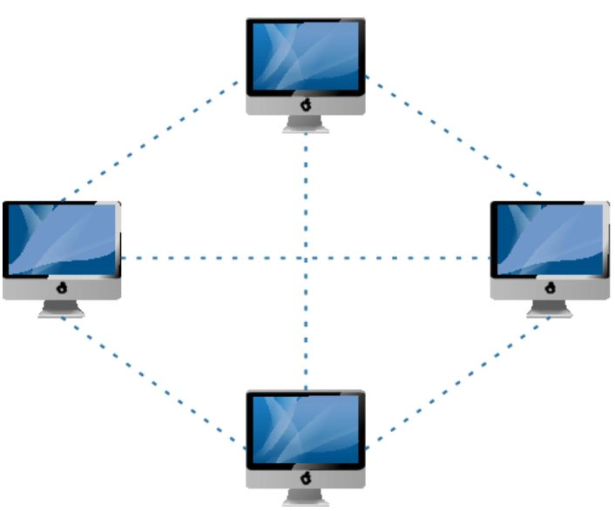
Peer-to-Peer Network
In this network, clients and servers are not differentiated which means no specific servers and clients
Focuses on connectivity
Each peer has its own data

Slide 23
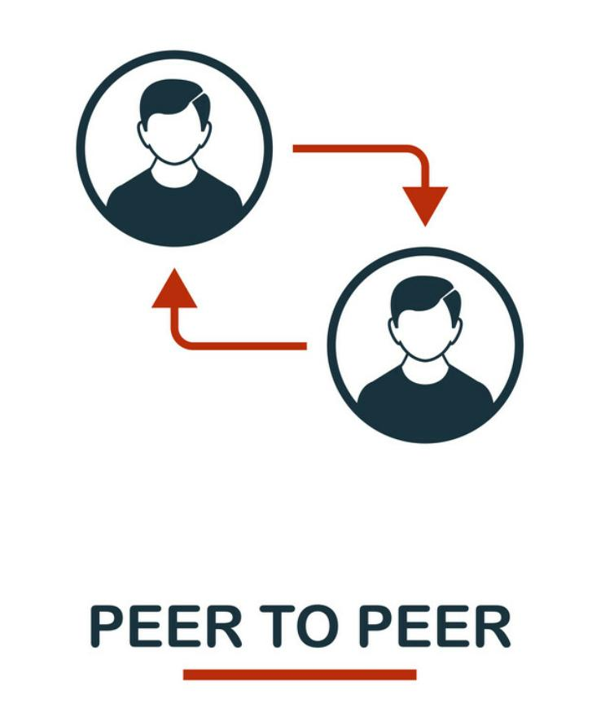
Peer-to-Peer Network
Advantages
Use less expensive computer hardware
Easy to administer
No NOS required
Easy set up and low cost
More reliable
Ideal for small business, home etc.

Slide 24

Peer-to-Peer Network
Disadvantages
Not very secure
Hard to maintain version control
Additional load on computer due to resource sharing
No central point of storage or file archiving

Slide 25


Slide 26

Funny Question ❓
What is the high speed data transfer medium ?

Slide 27


Answer:
Ans: Ximeki Aunties

Slide 28


